Slide 1
Introduction to Computer Science
Algorithms and programming languages

Slide 2
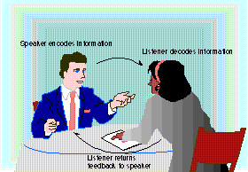
Communicating with a Computer
Communication cycle
One complete unit of communication.
An idea to be sent.
An encoder.
A sender.
A medium.
A receiver.
A decoder.
A response.
Speaker encodes information
Listener decodes information
Listener returns
feedback to speaker

Slide 3
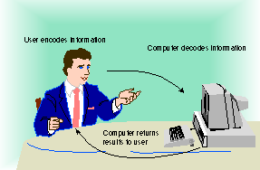
Communicating with a Computer
Substituting a computer for one of the people in the communication process.
Process is basically
the same.
Response may be symbols
on the monitor.
Speaker encodes information
Computer decodes information
Computer
returns results
to user

Slide 4
Communicating with a Computer
Programming languages bridge the gap between human thought processes and computer binary circuit.
Programming language: A series of specifically defined commands designed by human programmers to give directions to digital computers.
Commands are written as sets of instructions, called programs.
All programming language instructions must be expressed in binary code before the computer can perform them.

Slide 5
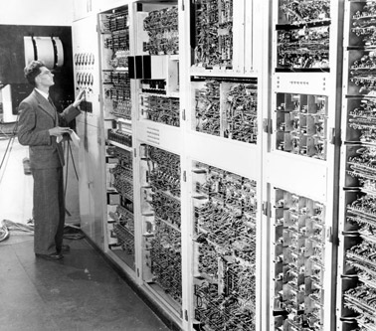
Programming language
First generation/Lowest level
Machine language (code)
Machine language programs were made up of instructions written in binary code.
This is the “native” language of the computer.
Each instruction had two parts: Operation code, Operand
Operation code (Opcode): The command part of a computer instruction.
Operand: The address of a specific location in the computer’s memory.
Hardware dependent: Could be performed by only one type of computer with a particular CPU.

Slide 6
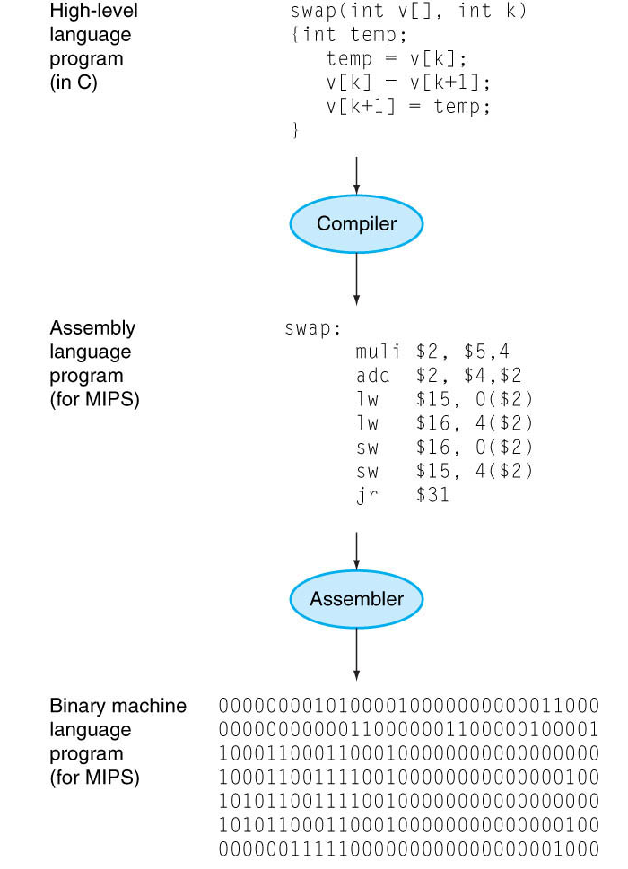
Programming language
You write programs in high level programming languages, e.g., C/C++, Java:
Compiler translates this into assembly language statement:
Assembler translates this statement into machine language instructions that the processor can execute:
A + B
add A, B
1000 1100 1010 0000

Slide 7
Programming language
Assembly language programs are made up of instructions written in mnemonics.
Mnemonics: Uses convenient alphabetic abbreviations to represent operation codes, and abstract symbols to represent operands.
Each instruction had two parts: Operation code, Operand
Hardware dependent.
Because programs are not written in 1s and 0s, the computer must first translate the program before it can be executed.
muli $s1, $s2, 2
add $s2, $s4,$s3
lw $s3, 0(s2)

Slide 8
Programming language
High-level languages
Instructions in these languages are called statements.
High-level languages: Use statements that resemble English phrases combined with mathematical terms needed to express the problem or task being programmed.
Transportable: NOT-Hardware dependent.
Because programs are not written in 1s and 0s, the computer must first translate the program before it can be executed.
Program sum2(input,output);
var
num1,num2,sum : integer;
begin
read(num1,num2);
sum:=num1+num2;
writeln(sum)
end.

Slide 9
Assembled, Compiled, or Interpreted Languages
All programs must be translated before their instructions can be executed.
Computer languages can be grouped according to which translation process is used to convert the instructions into binary code:
Assemblers
Interpreters
Compilers

Slide 10
Assembled, Compiled, or Interpreted Languages
Assembled languages:
Assembler: a program used to translate Assembly language programs.
Produces one line of binary code per original program statement.
The entire program is assembled before the program is sent to the computer for execution.

Slide 11
Assembled, Compiled, or Interpreted Languages
Interpreted Languages:
Interpreter: A program used to translate high-level programs.
Translates one line of the program into binary code at a time:
An instruction is fetched from the original source code.
The Interpreter checks the single instruction for errors. (If an error is found, translation and execution ceases. Otherwise…)
The instruction is translated into binary code.
The binary coded instruction is executed.
The fetch and execute process repeats for the entire program.

Slide 12
Assembled, Compiled, or Interpreted Languages
Compiled languages:
Compiler: a program used to translate high-level programs.
Translates the entire program into binary code before anything is sent to the CPU for execution.
The translation process for a compiled program:
First, the Compiler checks the entire program for syntax errors in the original source code.
Next, it translates all of the instructions into binary code.
Two versions of the same program exist: the original source code version, and the binary code version (object code).
Last, the CPU attempts execution only after the programmer requests that the program be executed.

Slide 13
Programming for Everyone
Several ways to control what your computer does or the way it accomplishes a particular task:
Using Macros
Using HTML to create Web Pages
Scripting
Each allows customization of current applications.

Slide 14
Building a Program
Whatever type of problem needs to be solved, a careful thought out plan of attack, called an algorithm, is needed before a computer solution can be determined.
1) Developing the algorithm.
2) Writing the program.
3) Documenting the program.
4) Testing and debugging the program.

Slide 15
Building a Program
Developing the algorithm.
Algorithm: A detailed description of the exact methods used for solving a particular problem.
To develop the algorithm, the programmer needs to do:
What data has to be fed into the computer?
What information do I want to get out of the computer?
Logic: Planning the processing of the program. It contains the instructions that cause the input data to be turned into the desired output data.

Slide 16
Building a Program
Writing the Program
If analysis and planning have been done, translating the plan into a programming language should be a quick and easy task.
Documenting the Program
During both the algorithm development and program writing stages, explanations called documentation are added to the code.
Helps users as well as programmers understand the exact processes to be performed.

Slide 17
Building a Program
Testing and Debugging the Program.
The program must be free of syntax errors.
The program must be free of logic errors.
The program must be reliable. (produces correct results)
The program must be robust. (able to detect execution errors)
Alpha testing: Testing within the company.
Beta testing: Testing under a wider set of conditions using “sophisticated” users from outside the company.

Slide 18
Algorithm

Slide 19
Objectives
Understand the concept of an algorithm.
Define and use the three constructs for developing algorithms: sequence, decision, and repetition.
Understand and use three tools to represent algorithms: flowchart, pseudocode, and structure chart.
Understand the concept of modularity and sub-algorithms.
List and comprehend common algorithms.

Slide 20
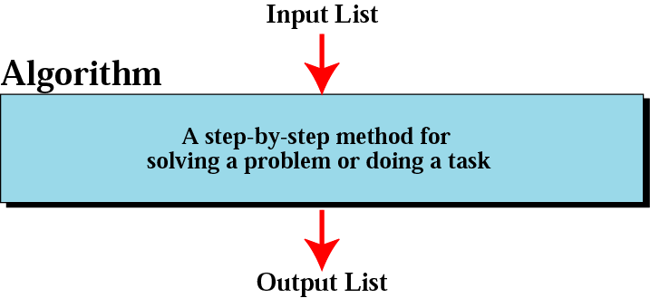
Informal definition of an algorithm used in a computer

Slide 21
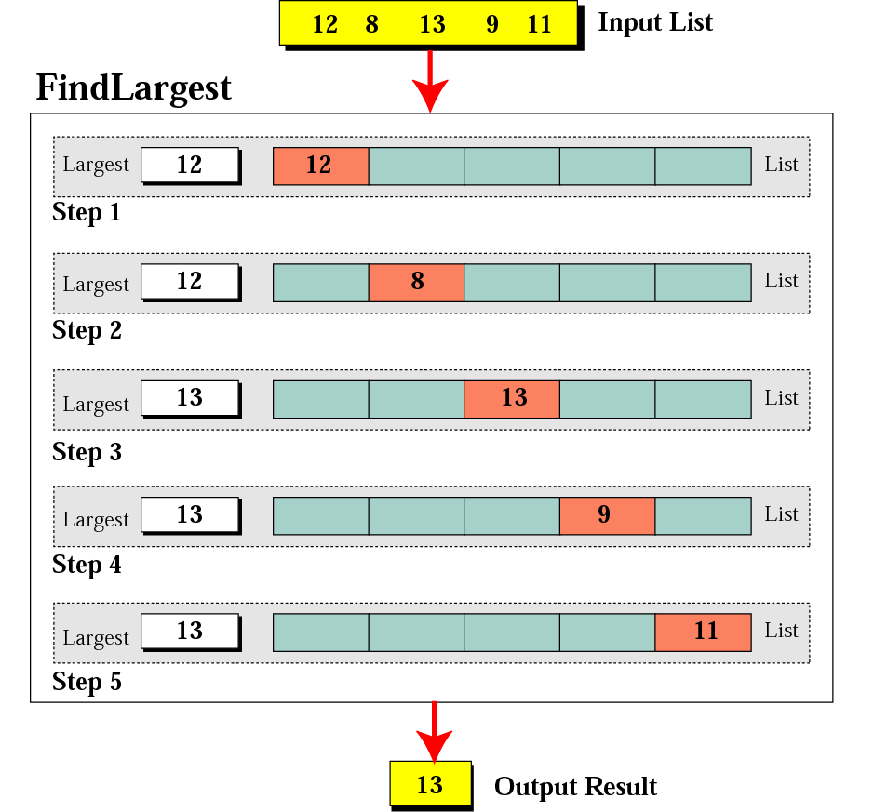
Example: Finding the largest number

Slide 22
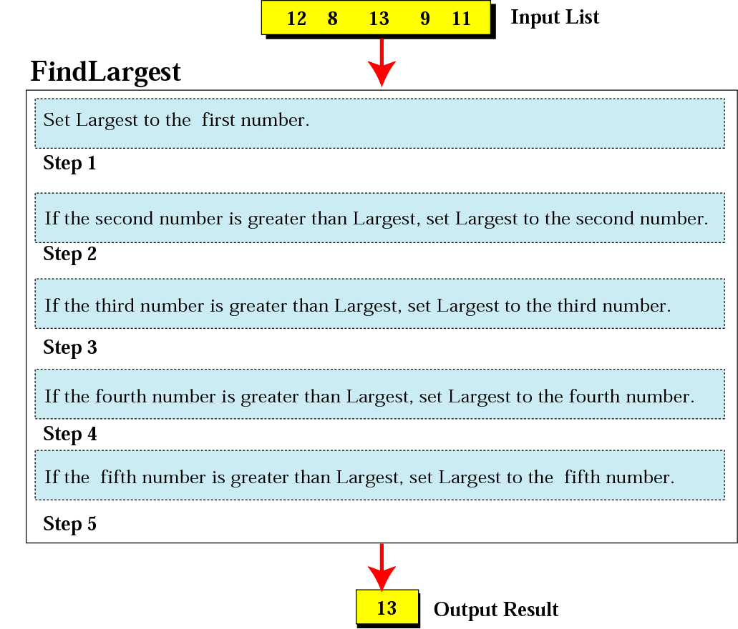
Example: Finding the largest number

Slide 23
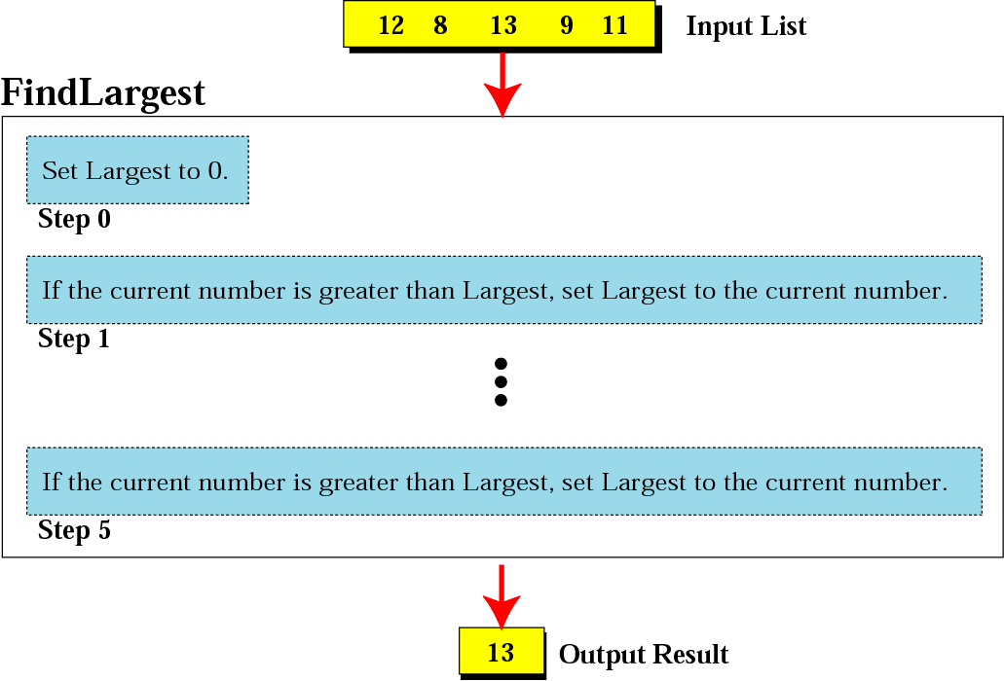
Example: Finding the largest number (refined)

Slide 24
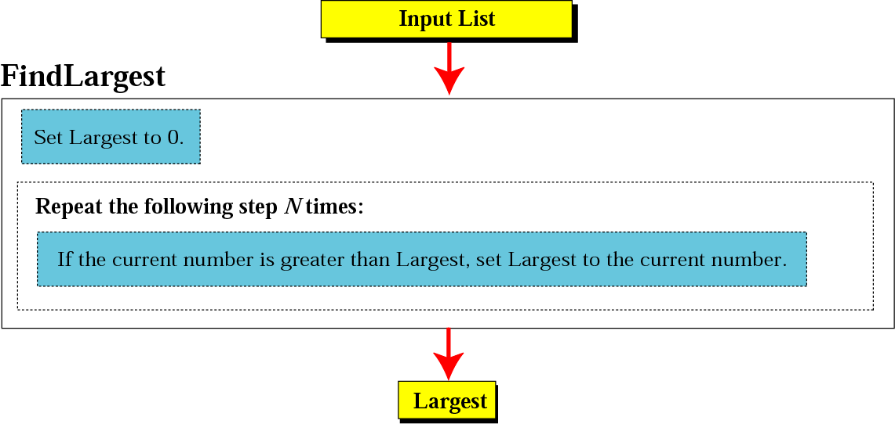
Example: Generalization of finding the largest number

Slide 25
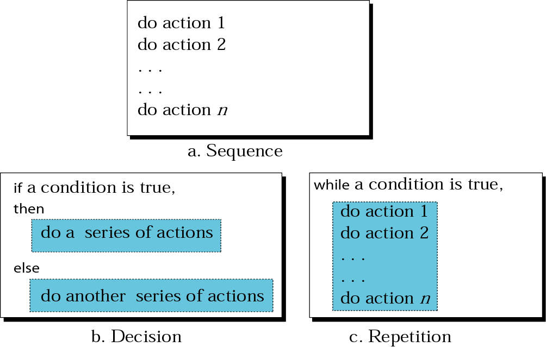
Three constructs

Slide 26
Notations for planning detailed algorithms
The three major notations for planning detailed algorithms:
Flowchart: Series of visual symbols representing the logical flow of a program.
Nassi-Schneidermann charts: Uses specific shapes and symbols to represent different types of program statements.
Pseudocode: A verbal shorthand method that closely resembles a programming language, but does not have to follow a rigid syntax structure.

Slide 27
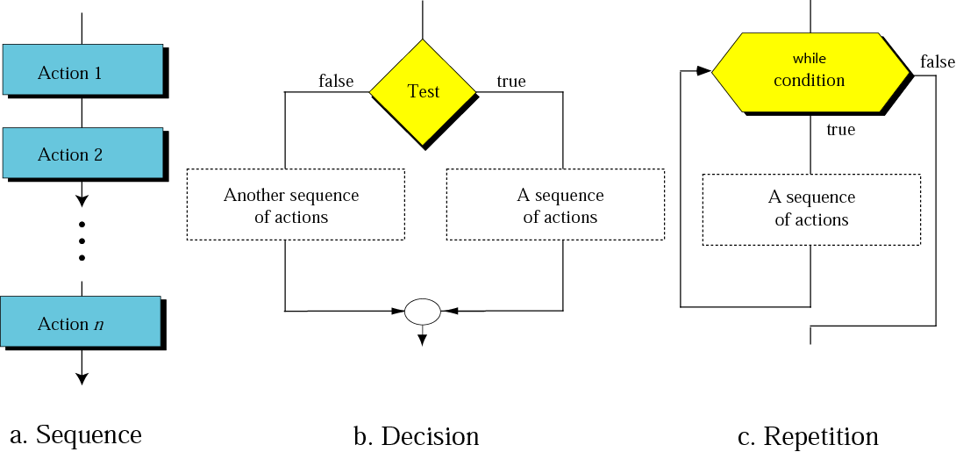
Flowcharts for three constructs

Slide 28
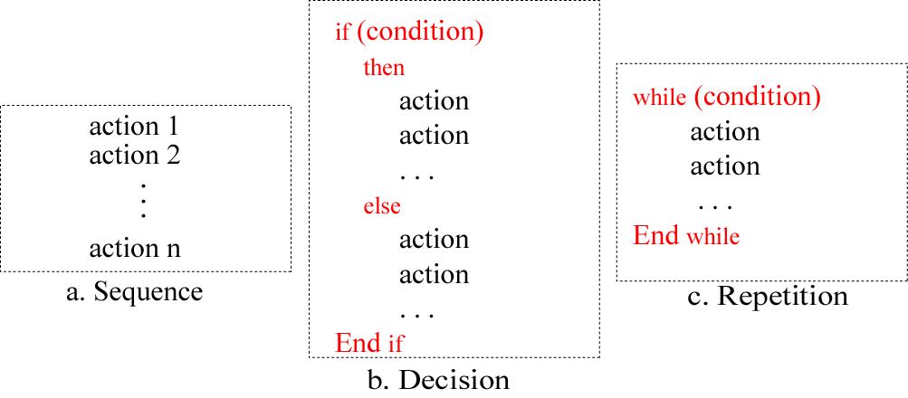
Pseudocode for three constructs

Slide 29
Example 1
Write an algorithm in pseudocode that finds the average of two numbers

Slide 30
Example 1
AverageOfTwo
Input: Two numbers
Add the two numbers
Divide the result by 2
Return the result by step 2
End

Slide 31
Example 2
Write an algorithm to find the largest of 1000 numbers.

Slide 32
Example 2
FindLargest
Input: 1000 positive integers
Set Largest to 0
Set Counter to 0
while (Counter less than 1000) 3.1 if (the integer is greater than Largest) then 3.1.1 Set Largest to the value of the integer End if 3.2 Increment Counter End while
Return Largest
End

Slide 33
More formal definition of algorithm
Ordered set
Unambiguous steps
Effectiveness
Termination

Slide 34
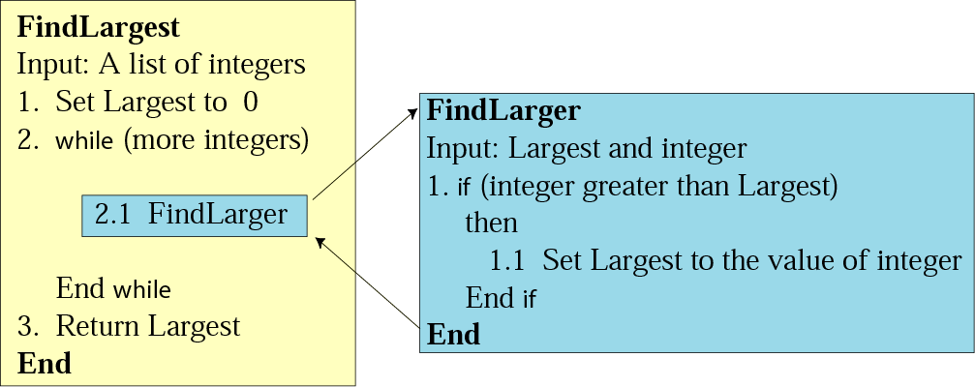
Subalgorithms
Subalgorithm

Slide 35
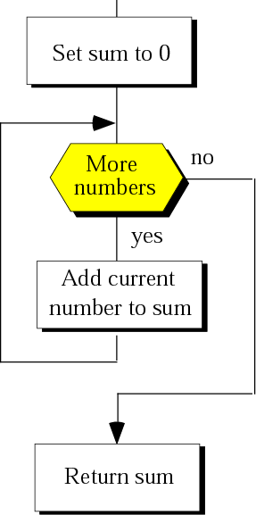
Some basic algorithms
Summation

Slide 36
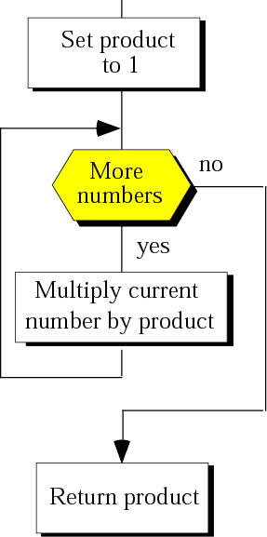
Some basic algorithms
Product

Slide 37
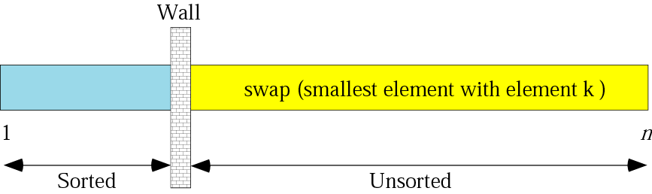
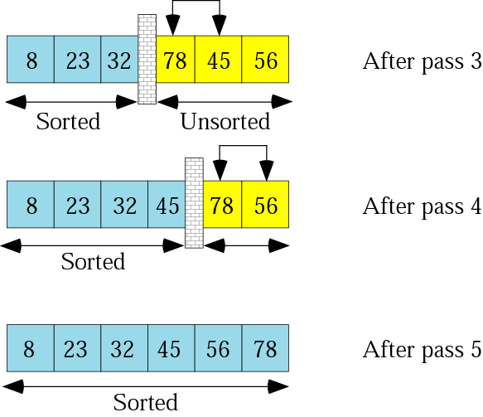
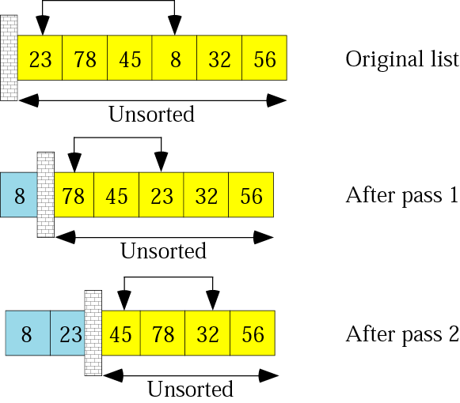
Some basic algorithms
Selection sort

Slide 38
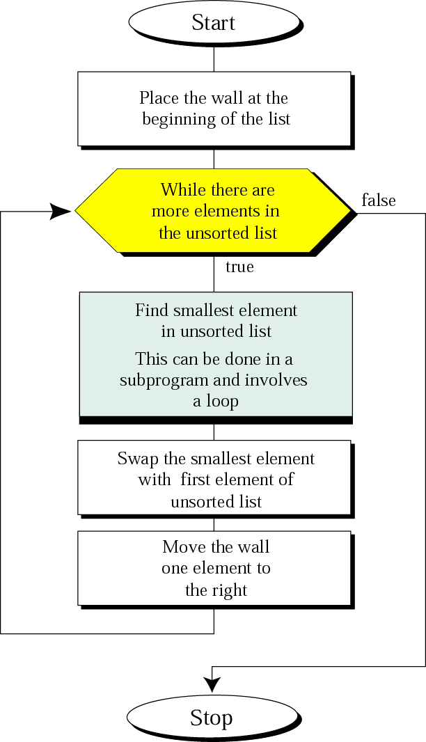
Some basic algorithms
Selection sort

Slide 39
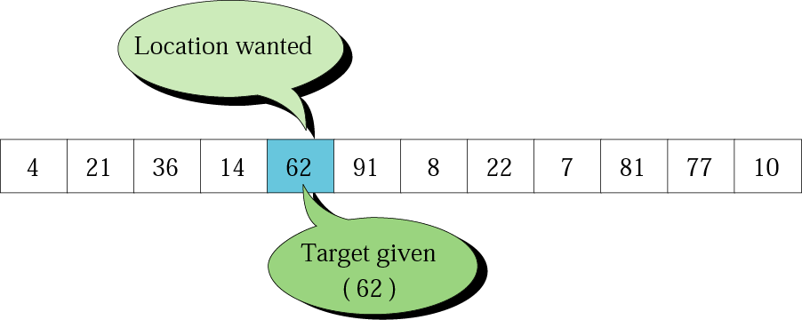
Some basic algorithms
Search concept

Slide 40
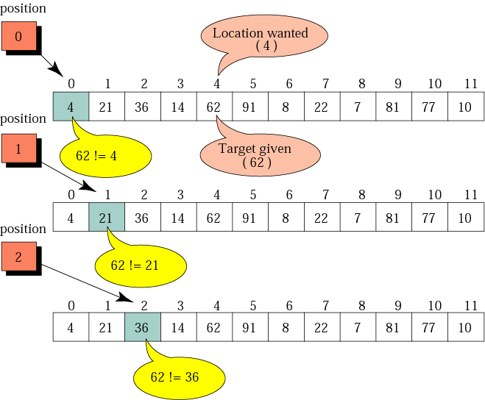
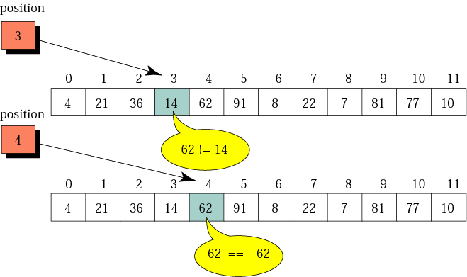
Some basic algorithms
Sequential search

Slide 41
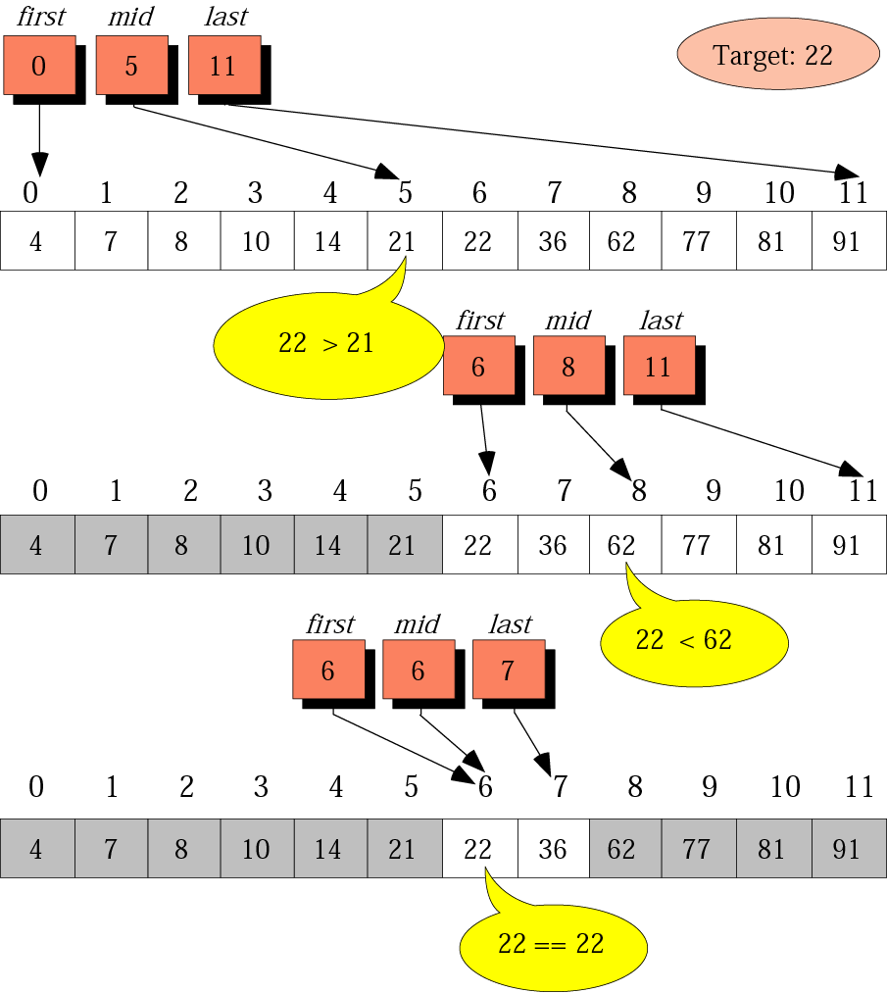
Some basic algorithms
Sequential search

Slide 42
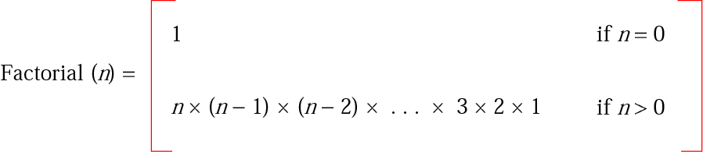
Recursion
Iterative definition of factorial

Slide 43
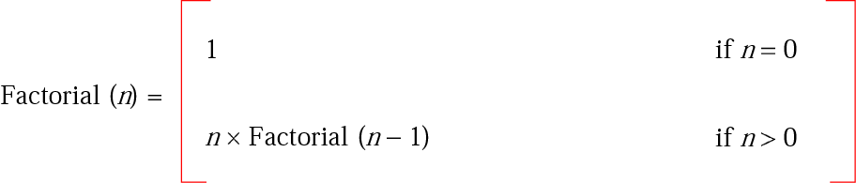
Recursion
Recursive definition of factorial

Slide 44
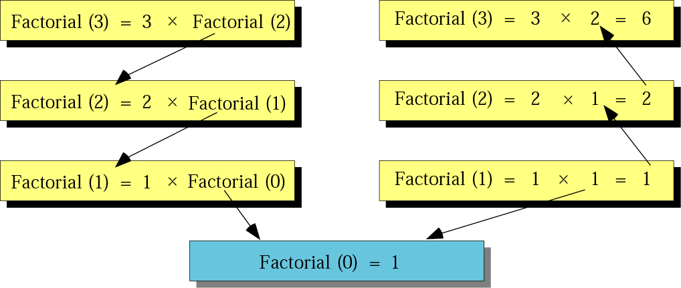
Recursion
Tracing recursive solution to factorial problem

Slide 45
Recursion
Iterative factorial
Factorial
Input: A positive integer num
Set FactN to 1
Set i to 1
while (i is less than or equal to num) 3.1 Set FactN to FactN x I 3.2 Increment i End while
Return FactN
End

Slide 46
Recursion
Recursive factorial
Factorial
Input: A positive integer num
if (num is equal to 0) then return 1 else return num x Factorial (num – 1) End if
End

